Slide 1
Should we tax robots?
The pace of industrial automation is accelerating across much of the developed and emerging market world

Slide 2
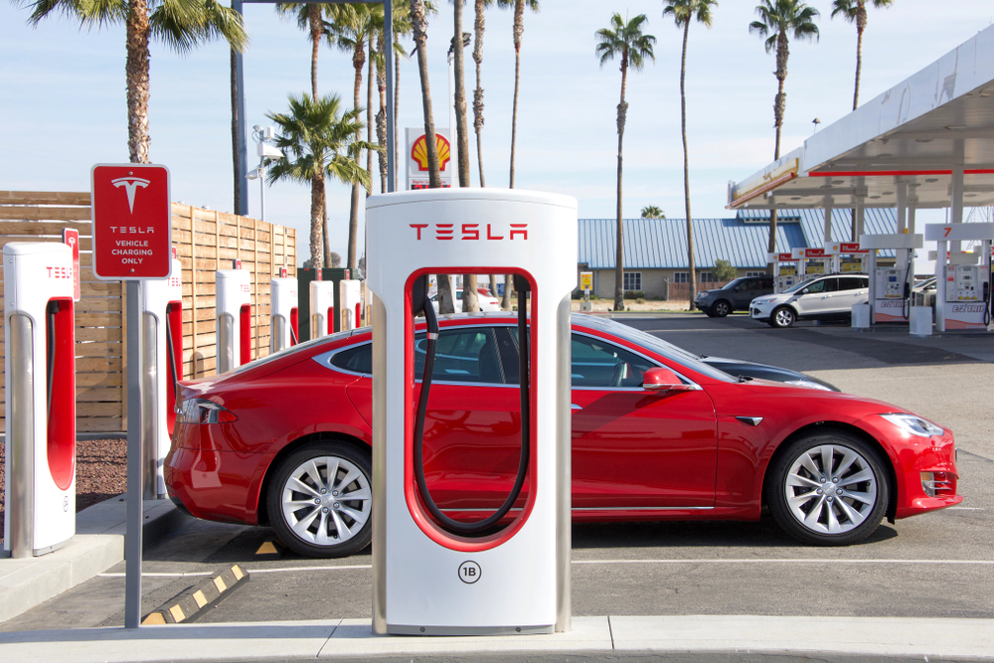
How soon will electric vehicles become the norm? Will they stimulate faster economic growth?

Slide 3
What can and what should be done about the gender pay gap?
Notes:
The gender pay gap measures the difference between average hourly earnings of men and women. Among full-time employees, women tend to be paid less per hour than men, while the opposite is true for part-time employees. Median hourly pay for full-time employees was 8.6% less for women than for men at April 2018, while median hourly pay for part-time employees was 4.4% higher for women than for men (figures exclude overtime pay). The median is the point at which half of people earn more and half earn less.

Slide 4
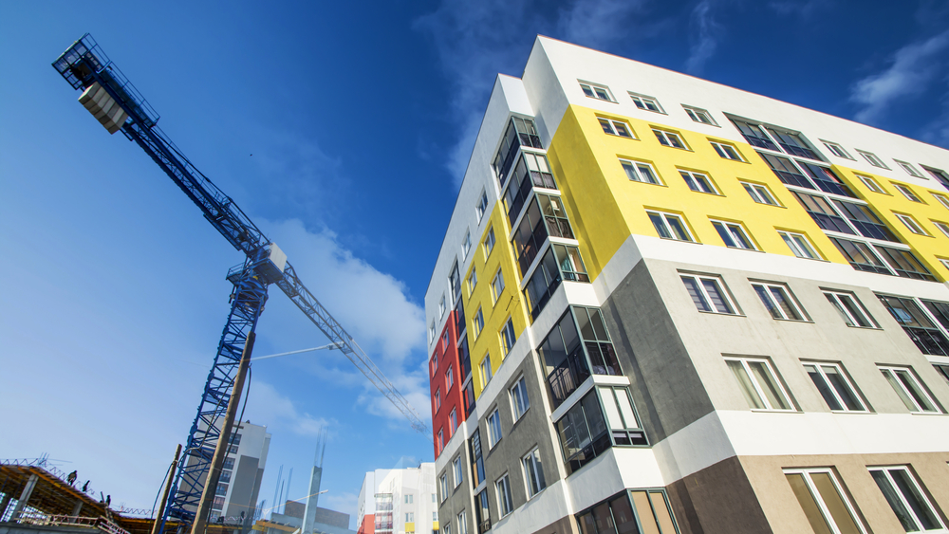
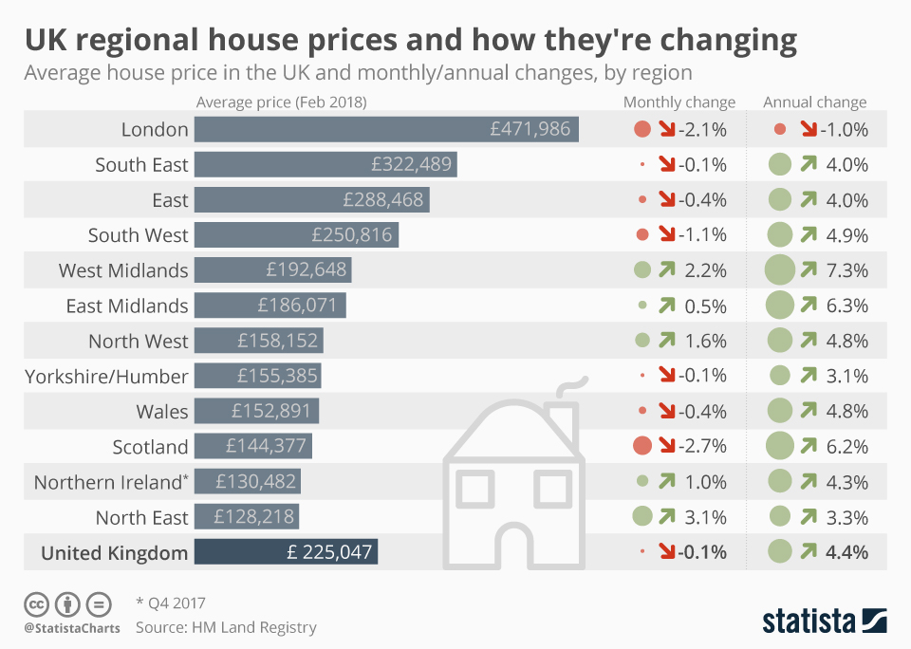
How can we make housing more affordable?
Notes:
Commentators are increasingly making the point that, in addition to a crisis in housing supply, England is in the grip of a crisis of affordability.

Slide 5
Does globalisation create more winners than losers? Is the age of globalisation coming to an end?
Notes:
The OECD defines globalisation as “the economic integration of different countries through growing freedom of movement across national boundaries of goods, services, capital and people”. Globalisation has coincided with a decrease in extreme global poverty and a decrease in inequality between countries. However, globalisation has also coincided with an increase in inequality within countries according to some measures, and can have both positive and negative effects on the labour market in developed economies.

Slide 6
Is there a future for cash?
In Sweden, 19 per cent of payments are made using cash, compared with a European average of nearly 80 per cent
In the UK, there were 13.2billion debit card payments in 2017, eclipsing the 13.1billion payments in cash. 3.4million people said they almost never used notes and coins.

