Slide 1
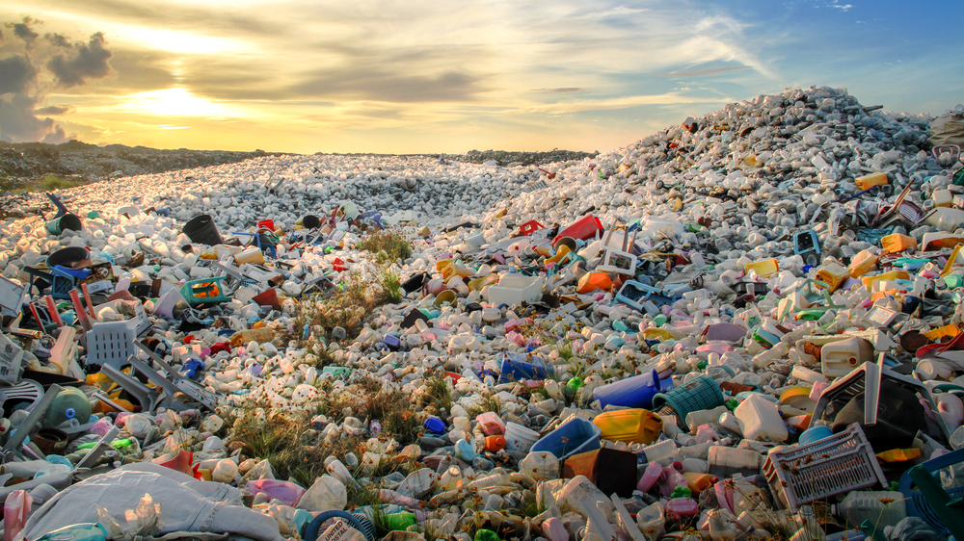
Which policies are effective in curbing the plastic pollution crisis?
Notes:
In 2016, the world generated 242 million metric tons of plastic waste—12 percent of all municipal solid waste, according to the What a Waste report.
Some 90 percent of floating marine debris is plastic, of which nearly 62 percent is food and beverage packaging

Slide 2
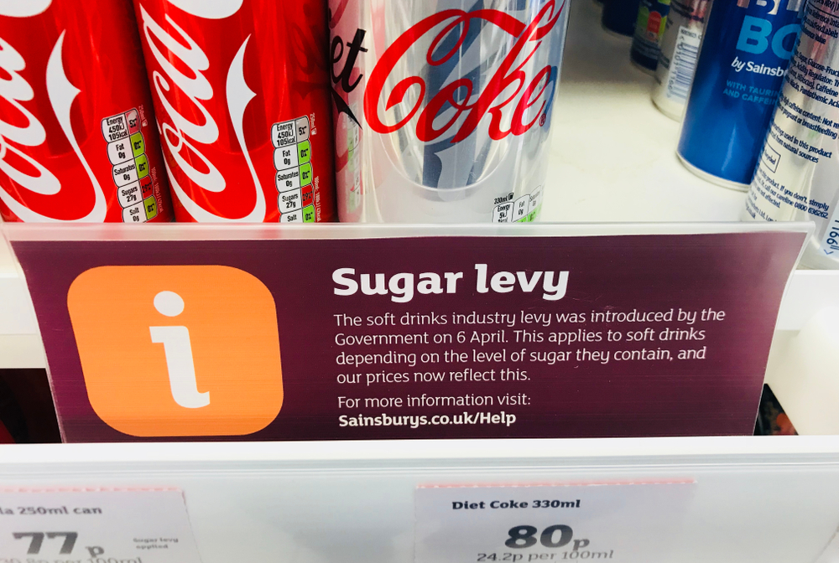
The sugar tax – is it an effective way to tackle the social costs of obesity?

Slide 3
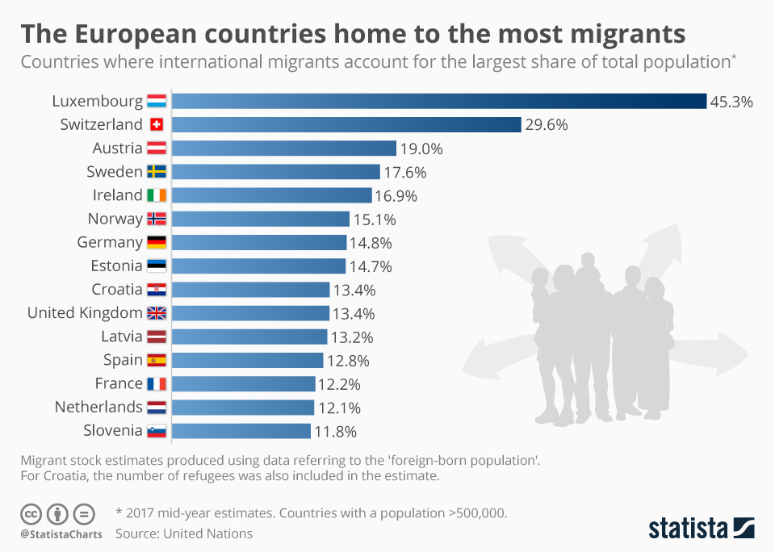
Is labour migration good for an economy in the long run?
Notes:
For the UK,
In the year ending June 2018: 625,000 people migrated into the UK and 351,000 people emigrated from it, leaving a net migration figure of +273,000. This represents the balance of long-term migrants moving in and out of the country.
6.2 million people were living in the UK who had the nationality of a different country (9% of the total population).
3.7 million EU nationals (excluding UK) were living in the UK.
785,000 UK nationals were living in other EU countries excluding Ireland.
The number of people migrating to the UK has been greater than the number emigrating since 1994

Slide 4
Who are the winners and losers from trade wars?

Slide 5
What is the future of work in a world of artificial intelligence?

