Slide 1
Barnsley Sixth Form College A Level PE Quiz
Tutor: Joe Palmer

Slide 2
Can you name the different food groups that make up a balanced diet?

Slide 3
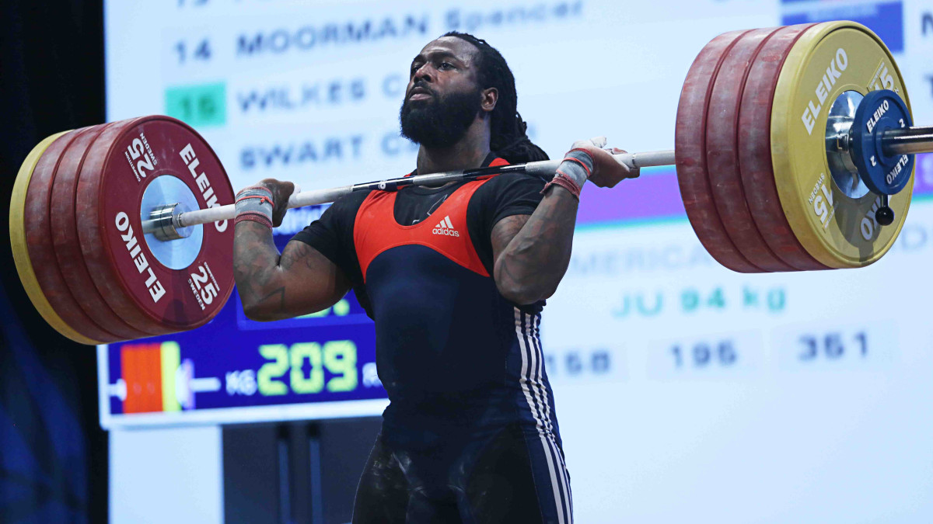
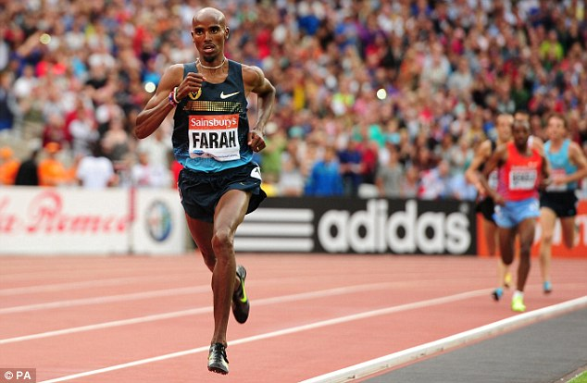
How would the diets of these two athletes differ?

Slide 4
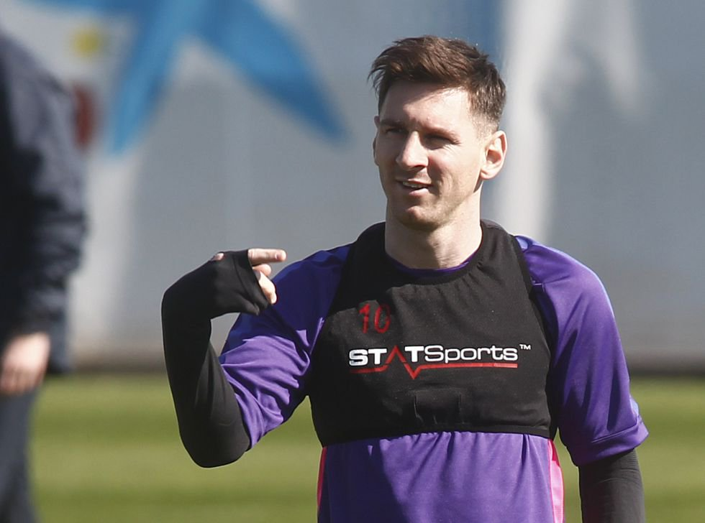
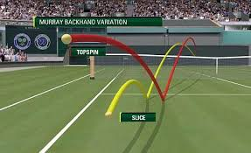
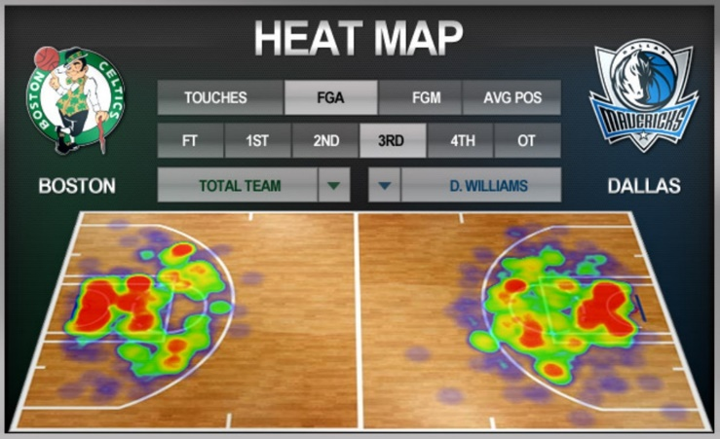
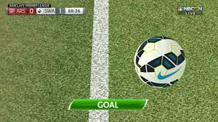
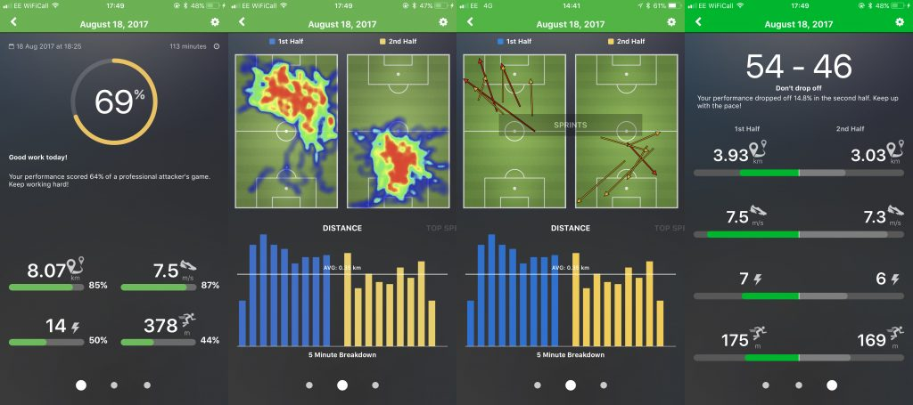
Can you think of five uses of technology in sport?

Slide 5
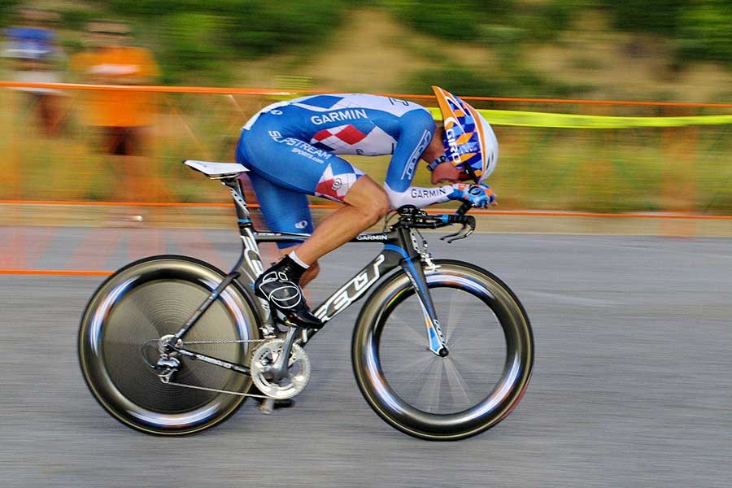
How do elite athletes reduce the forces acting upon them (drag/air resistance etc.)?
Use the picture to help!

Slide 6
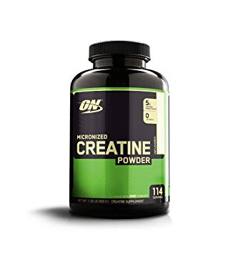
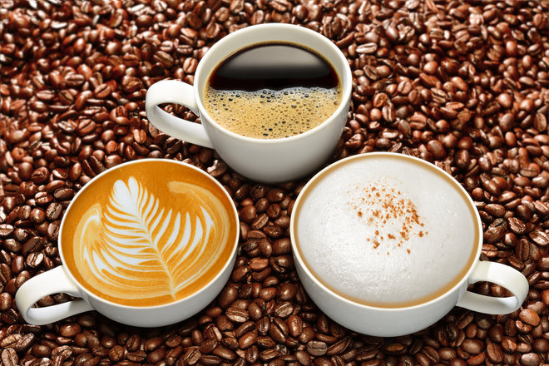
Supplements
Name an athlete that would benefit from each of the following supplements used in sport…
Creatine:
Increases PC stores
Work explosively for longer
Therefore increases muscle mass
Sodium Bicarbonate:
Prevents the build up of lactic acid
Caffeine:
Increases alertness
Promotes the use of fats for energy, which saves carbohydrate stores

Slide 7
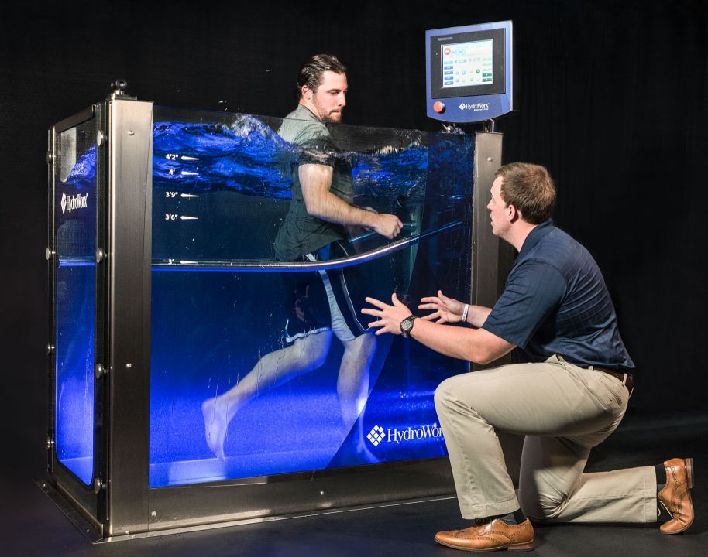
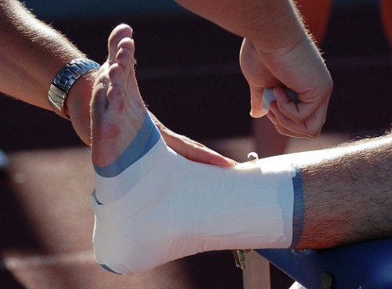
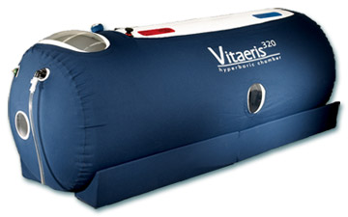
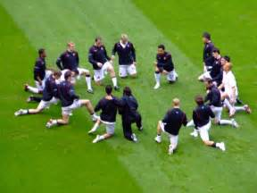
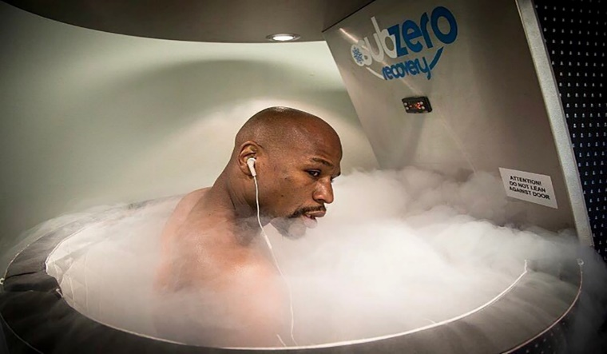
Injury prevention and the rehabilitation of injury
Can you think of any methods that help protect from/speed up recovery from injury?

Slide 8
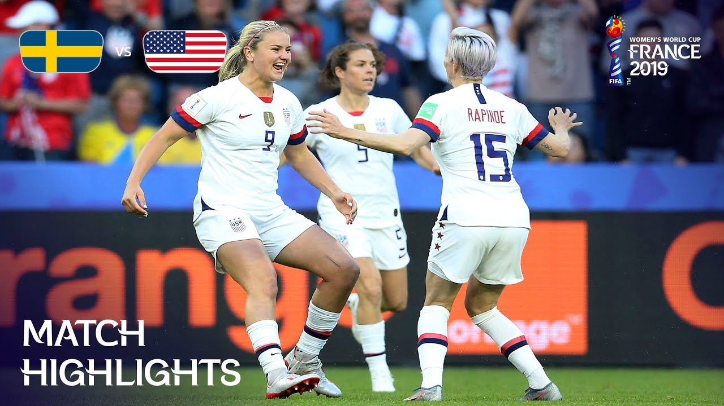
How much prize money is awarded by FIFA at the: a) Women's football world cup b) Men's football world cup

Slide 9
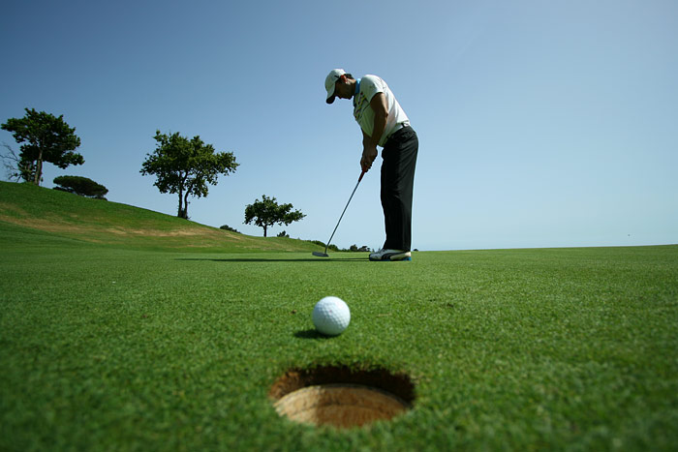
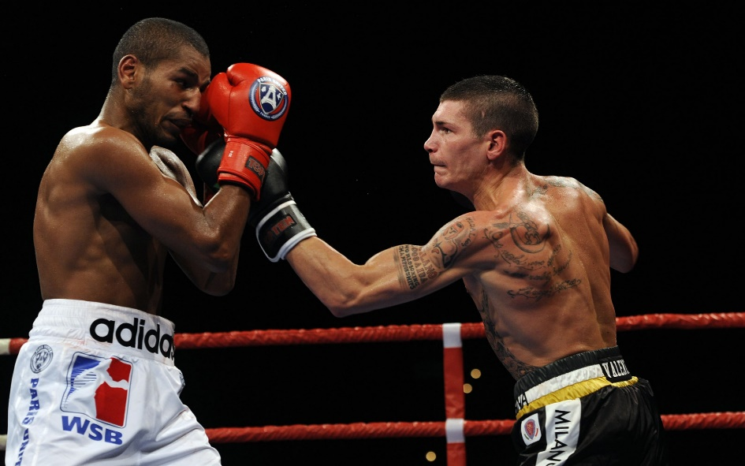
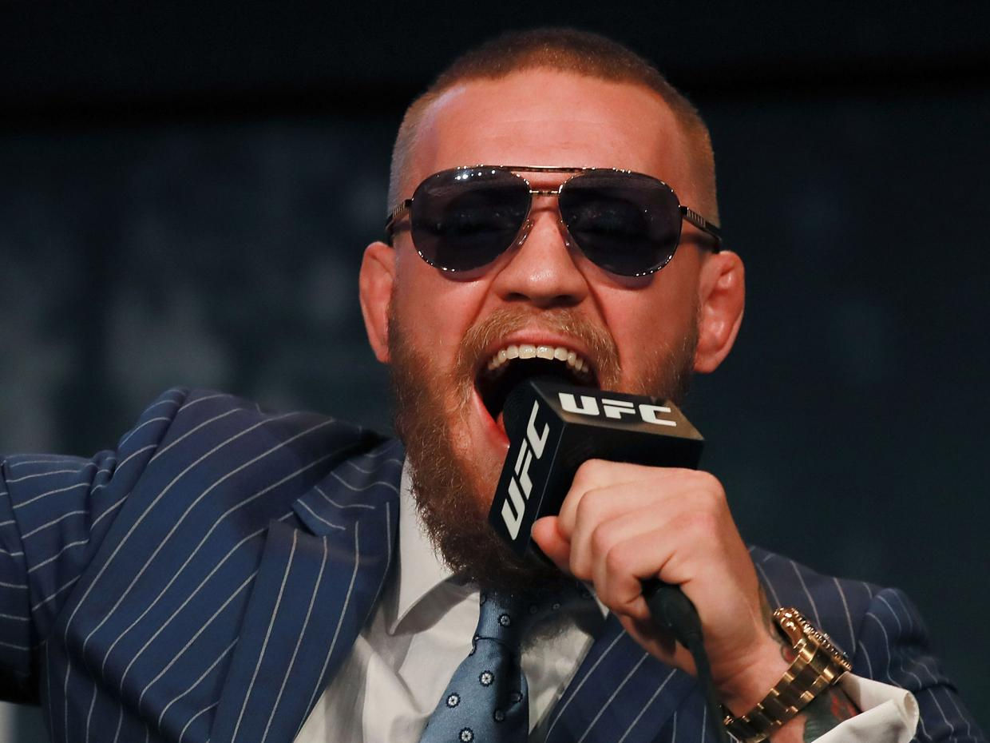
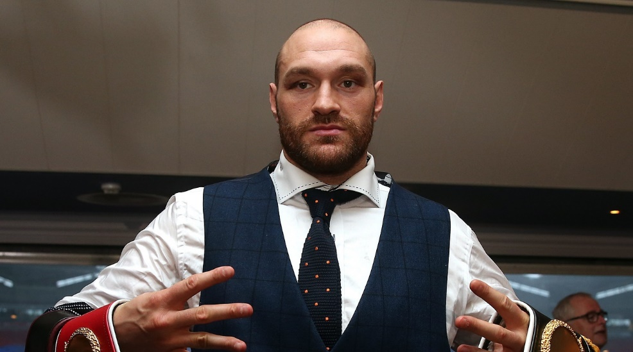
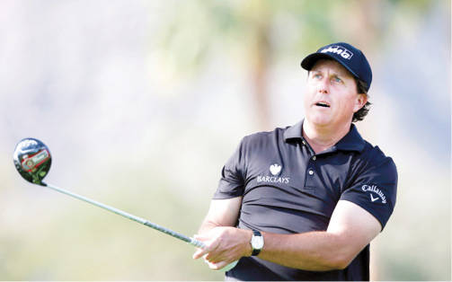
Is an athletes personality important in sport?
What type of personality do you think is needed in…
Boxing/UFC
Golf

Slide 10
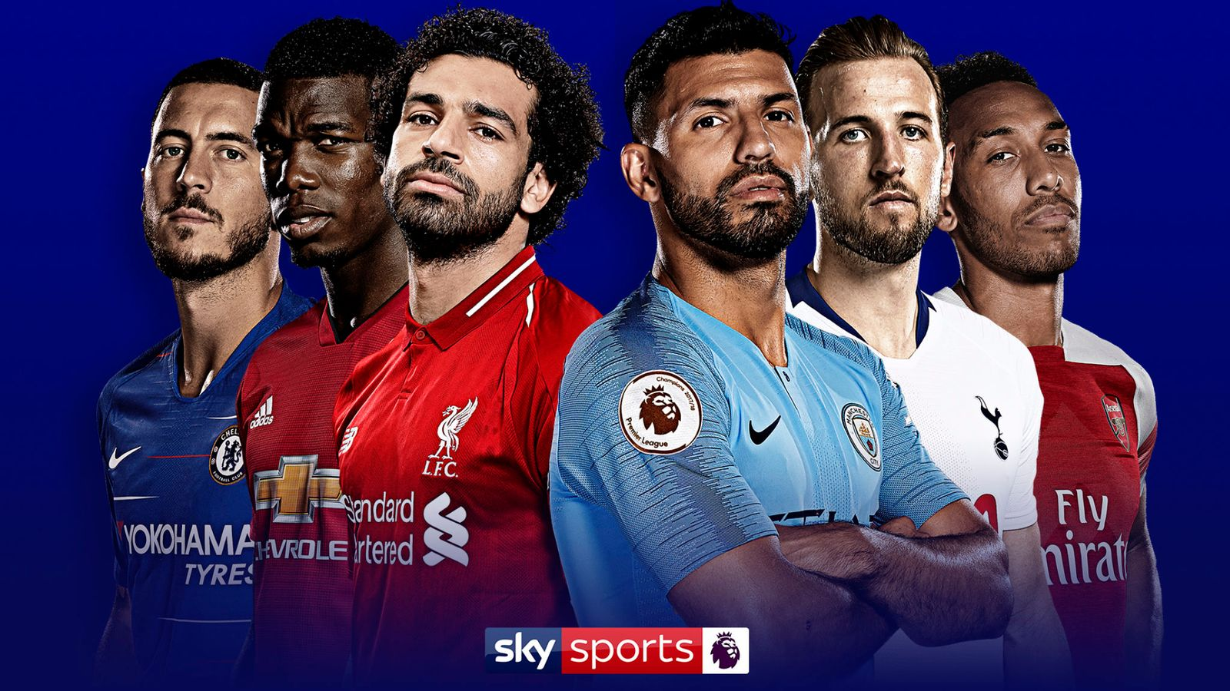
How much money did sky sports pay for the Premier League TV contract (2016-2019)
£5.2 billion

Slide 11
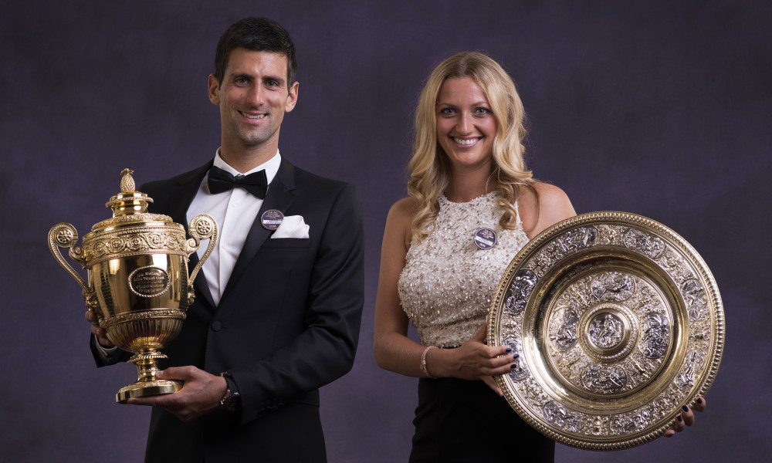
What is the prize money at Wimbledon for the male and female singles champion?
£2.35 million

Slide 12
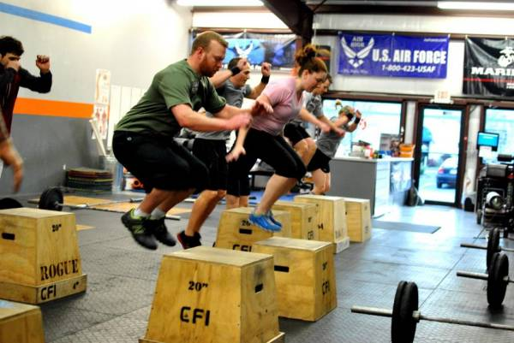
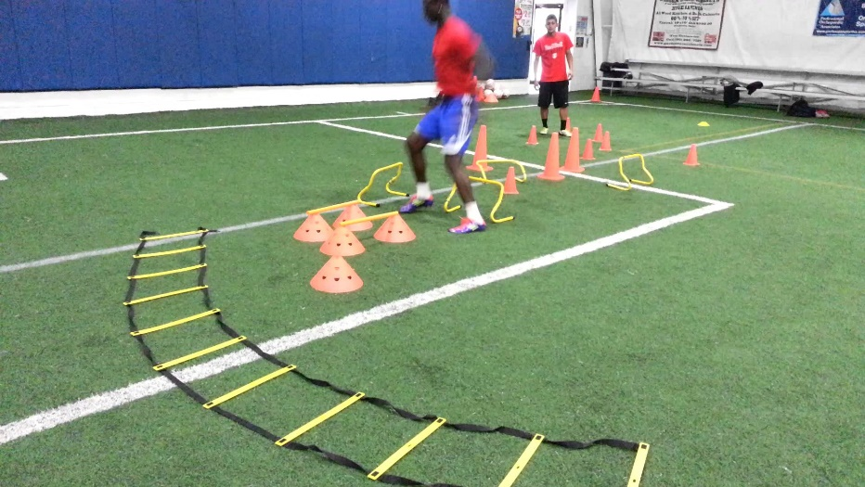
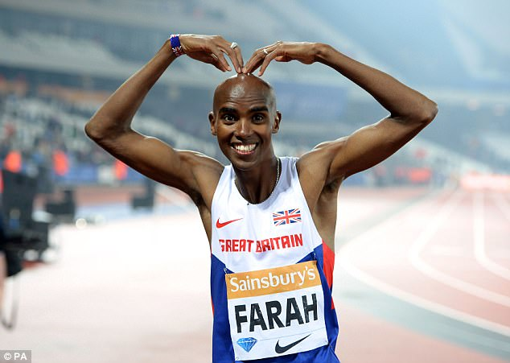
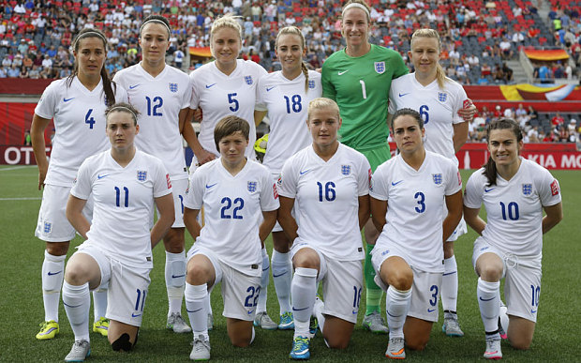
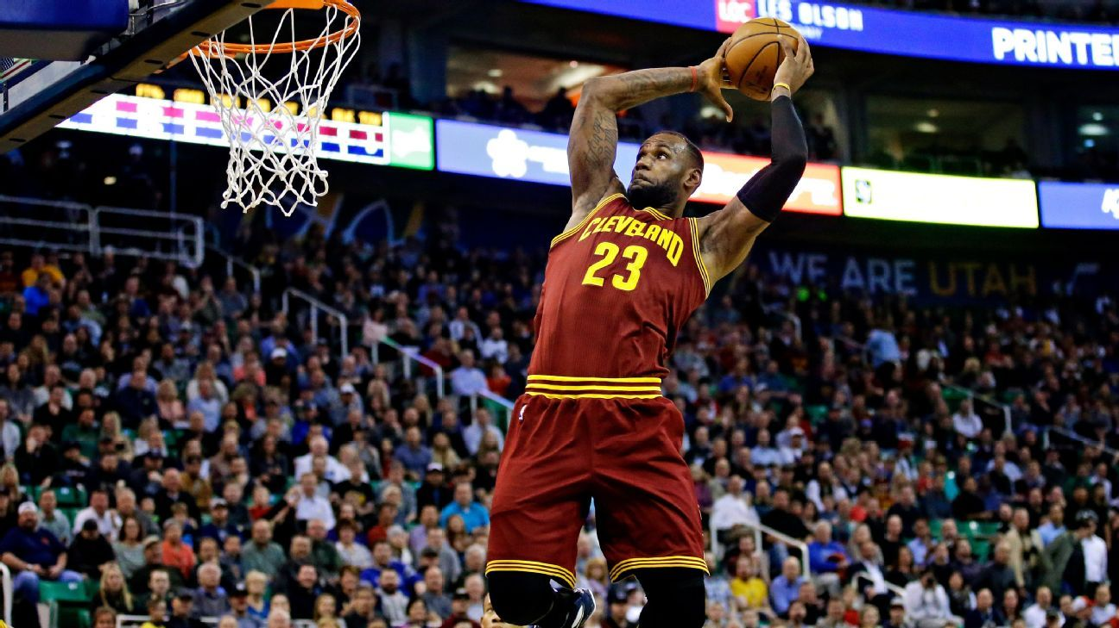
Match the athlete to the training method

Slide 13
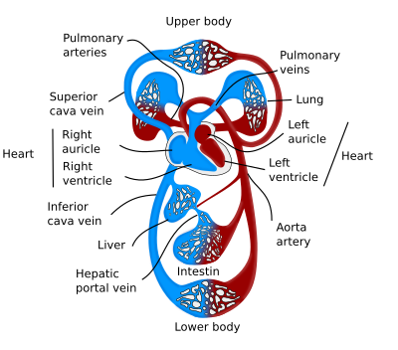
What are the long term effects of aerobic exercise?

Slide 14
Any Questions? j.palmer@barnsley.ac.uk

