Slide 1
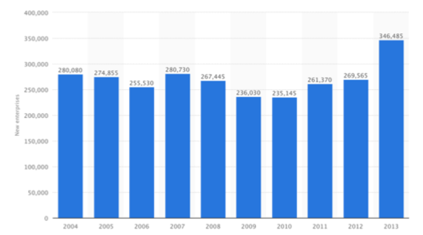
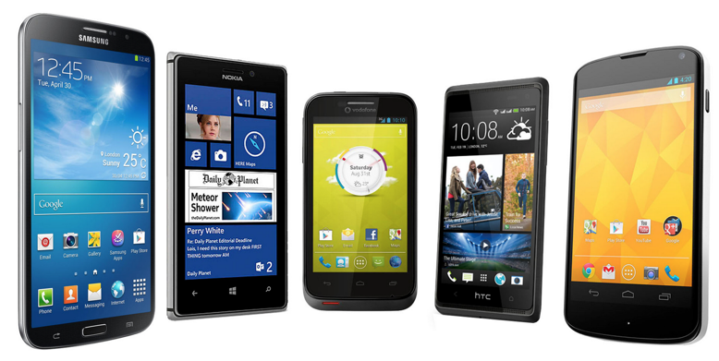
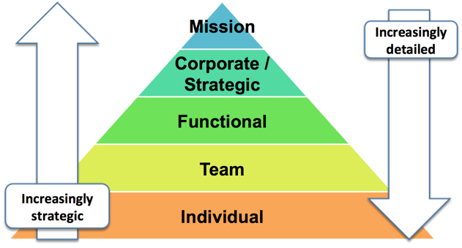
What is Business?
3.1 What is Business?

Slide 2
What you need to know
What is a business?
Role of an entrepreneur
Common business objectives
Business mission, vision & aims

Slide 3
Definition of a Business
A business is an organisation that exists to provide goods and services on a commercial basis to customers

Slide 4
Why Businesses Exist
Businesses exist to provide goods and services on a commercial basis to customers
GOODS
SERVICES
Goods are physical products: e.g. consumer electronics, industrial components, cars
Services are intangible products: e.g. insurance, dental services, cleaning

Slide 5
The Benefits of Business to Society
Create Employment & Develop Human Capital
Drive Innovation through R&D and New Products
Pay Taxes on profits earned & collect taxes for Govt.
Create Wealth by providing returns on investment

Slide 6
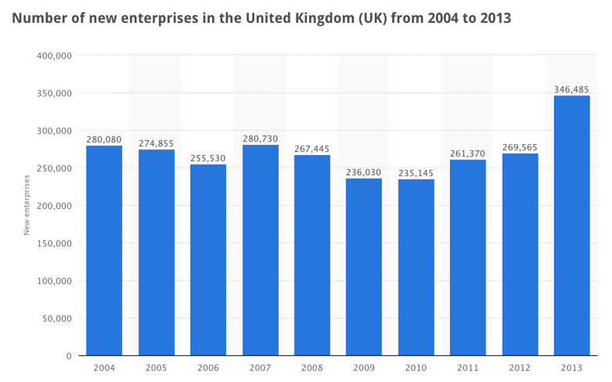
Entrepreneurs are the Driving Force Behind New Businesses (Startups)

Slide 7
What is a Start-up?
A start-up is a new business enterprise, formed by one or more entrepreneurs

Slide 8
The Role of the Entrepreneur
Spots business opportunities
Takes (calculated) risks in order to gain possible future returns
Acts a catalyst for the creation & growth of new business enterprises

Slide 9
What Happens in a Business? The Transformation Process
Inputs
Outputs
Transformation
Process
The transformation process describes what happens inside the business. This is where value is added to inputs to create outputs

Slide 10
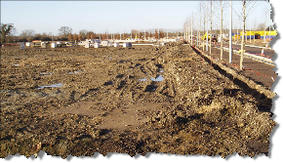
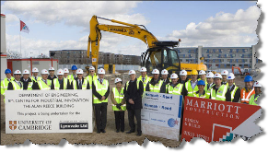
Key Inputs into the Transformation Process
Land
Labour
Capital
Enterprise

Slide 11
Outputs – the main Business Sectors
Sector | Description | Examples
Primary | Extraction of natural resources | Mining, farming, energy extraction
Secondary | Production of finished goods and components | Manufacturing, food processing, component assembly, raw material processing
Tertiary | Providing services to consumers and businesses | Personal services (e.g. beauticians), retailing, household franchises
Quaternary | Providing information & ICT | Software development, financial services, data processing

Slide 12
The Relationship between Mission and Objectives
Mission
Aims
Core Values
Objectives

Slide 13
What are Business Objectives?
The specific intended outcomes of business strategy
The anticipated end results of a programme of activities
Targets which the business adopts in order to achieve its primary aims

Slide 14
Main functions of objectives
A clear statement of what needs to be achieved
A focus for all activity
Targets for individual and group achievement
A means of measuring performance

Slide 15
The Hierarchy of Objectives in Business
Mission
Corporate /
Strategic
Functional
Team
Individual
Increasingly
detailed
Increasingly
strategic

Slide 16
How objectives can be used
Implement the mission
Provide a clear focus for decision making
Provide a target
Motivate employees
Facilitate control of actual performance
Provide a criteria for evaluating performance
Reduce uncertainty
Provide a sense of unity

Slide 17
How the Hierarchy Works
The objectives cascade down from the mission getting progressively more specific
Overall objectives are translated into more specific objectives for different parts of the business
The hierarchy ensures that at each level the objectives are consistent with the objectives that are above them in the hierarchy

Slide 18
Mission…aim…objective
Mission
A qualitative statement of the business’s aims
Aim
A long term plan from which business objectives are derived
Objective
A target which must be achieved in order to realise the stated aim
A time assigned targets derived from the goals and set in advance of strategy

Slide 19
Corporate objectives are often stated in terms of…
Profit (value, margin)
Return on investment (ROCE)
Growth (profit, earnings per share)
Market share
Cash flow
Sales revenue
Shareholder value
Corporate image & reputation

Slide 20
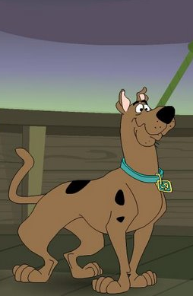
Functional Objectives are there to Serve the (Master) Corporate Objectives
Master
Servant
Corporate
Functional

Slide 21
Examples of Relationship between Corporate and Functional Objectives
Corporate Objective | Example Functional Objective
Increase sales | Successfully launch five new products in the next two years (marketing)
Reduce costs | Increase factory productivity by 10% by 2018 (operations)
Increase cash flow | Reduce the average time taken by customers to pay invoices from 75 to 60 days (finance)
Improve customer satisfaction | Achieve a 95% level of high customer service (people)

Slide 22
Ideally, Business Objectives Should be SMART
SMART
acronym helps management set effective objectives

Slide 23
SMART Objectives
S | Specific | The objective should state exactly what is to be achieved
M | Measurable | An objective should be capable of measurement – so that it is possible to determine whether (or how far) it has been achieved
A | Achievable | The objective should be realistic given the circumstances in which it is set and the resources available to the business
R | Relevant | Objectives should be relevant to the people responsible for achieving them
T | Time Bound | Objectives should be set with a time-frame in mind. These deadlines also need to be realistic

Slide 24
Many Factors Can Influence Business Objectives
Age of the business
Size and legal status
Ownership
Views of owners and managers
Market conditions
Legislation
State of the economy
Competition
Risk and attitude to risk
Corporate culture
Political factors
Social attitudes

Slide 25
Strategic v Tactical objectives
Strategic | Tactical
Focused on long-term | Focused on short-term
Set by the Board | Set by line management
Involve higher risk & uncertainty | Relatively low-risk
Likely to involve significant investment / business resources | Limited resources invested
Difficult to change in the short-term | Relatively easy to change at minor financial cost
Stretching & challenging | Realistic & achievable

Slide 26
The Mission Statement is…
The overriding goal of the business
The reason for its existence
A strategic perspective
A vision for the future

Slide 27
What Makes a Good Mission?
Contains a formulation of objectives that enables progress towards them to be measured
Differentiates the business from its competitors
Defines the markets or business in which the firm wants to operate
Is relevant to all major stakeholders - not just shareholders and managers
Excites, inspires, motivates & guides

Slide 28
Common Criticisms of Mission Statements
Not always supported by actions of the business
Often too vague and general
Often merely statements of the obvious
Often seen as a PR exercise
Sometimes regarded cynically by staff
Sometimes not a true reflection of reality
To mean anything they must be supported wholeheartedly by senior management

